Slide 1
Predicting Credit Card Approvals: A Classification-Based Approach
PRESENTED BY:
GROUP NUMBER 2
BHAVANS VIVEKANANDA DEGREE COLLEGE
GROUP MEMBERS:
HARSHIT KUMAR/SRIKANTH YADAV/CHAITANYA JADAV

Slide 2

ABSTRACT
Purpose: TO Analyze applicant profiles to understand factors affecting credit approval decisions and help Financial Institutes make better decisions
Focus Attributes: Age, Income, Debt levels, Employment stability, Credit history.
Goal: Identify patterns and key drivers behind credit approvals for data-driven decision-making.
Outcome : Support development of fair, transparent, and equitable lending practices.
Provide actionable insights to improve credit scoring models.
Help financial institutions balance risk management with inclusive credit access.

Slide 3

OBJECTIVES
Identify Key Drivers: Determine which factors (e.g., income, debt, credit history) most significantly impact credit approval decisions.
Support Fair Lending: Analyze trends to ensure that credit decisions are made equitably and without bias.
Improve Credit Scoring Models: Use insights from data to enhance existing credit scoring models, leading to more accurate and inclusive approval processes.
Enhance Transparency: Provide data-backed insights to foster a transparent credit approval process that stakeholders can understand and trust.
Assist Risk Management: Help financial institutions mitigate risk by providing a clearer understanding of applicant profiles and their creditworthiness.

Slide 4

CONTENT
Introduction 5
Literature Review 6
Data Preprocessing 9
Exploratory Data Analysis 12
Machine Learning Algorithms 19
Summary 27
Insights and Future scope 28 27
Appendix 32

Slide 5
INTRODUCTION
Credit Approval Process: A vital step for financial institutions to determine an applicant's eligibility for credit.
Importance: Ensures responsible lending by evaluating applicants' financial profiles.
Helps in maintaining financial stability by reducing credit risk.
Promotes fair access to credit for diverse applicant backgrounds.
Dataset: Comprises detailed applicant information, including \age, income, debt levels, employment stability, and credit history.
Focus: Understanding applicant characteristics that influence credit decisions.
Highlighting data-driven trends that align with fair and transparent lending practices.

Slide 6
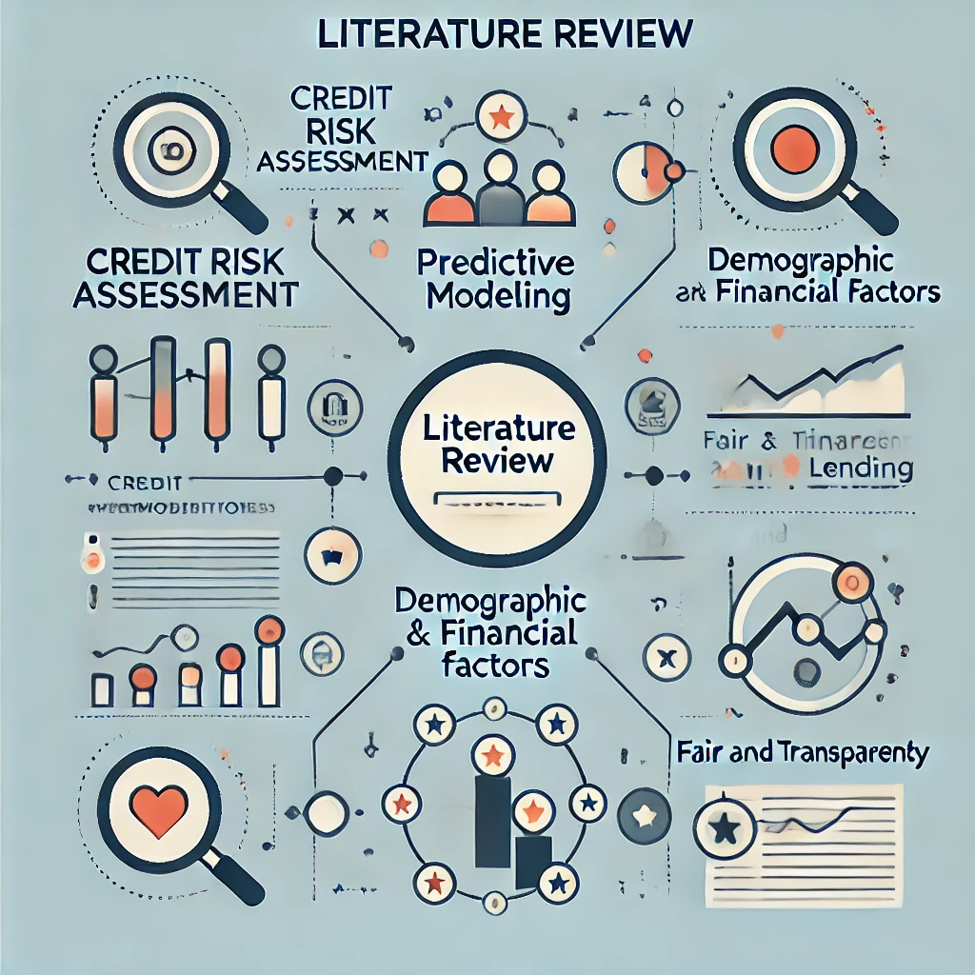
LITERATURE
REVIEW

Slide 7
LITERATURE REVIEW- 1
Peela, H.V., Gupta, T., Rathod, N., Bose, T. and Sharma, N., Prediction of Credit Card Approval. International Journal of Soft Computing and Engineering.
Peela et al. (2021) analyzed machine learning approaches for predicting credit card approvals, comparing models such as logistic regression, decision trees, and random forests. Their study focuses on identifying applicant features most influential in approval decisions and demonstrates that ensemble methods, especially random forests, excels in predictive accuracy. The research underscores the effectiveness of machine learning in simplifying and improving the credit approval process, emphasizing the role of feature selection in optimizing model performance.

Slide 8
LITERATURE REVIEW- II
Nandipati, V.S.S. and Boddala, L.V., 2024. Credit Card Approval Prediction: A comparative analysis between Logistic Regression, KNN, Decision Trees, Random Forest, XGBoost.
Nandipati and Boddala (2024) present a comparative analysis of machine learning models—logistic regression, KNN, decision trees, random forests, and XGBoost—for predicting credit card approvals. Their study assesses each model's accuracy, interpretability, and efficiency, finding that while XGBoost offers the highest predictive accuracy, logistic regression remains useful due to its interpretability. The authors suggest that although advanced models provide accuracy gains, simpler models like logistic regression and decision trees can be advantageous in contexts where interpretability and processing speed are prioritized for practical credit approval decisions.

Slide 9

DATA PREPROCESSING

Slide 10
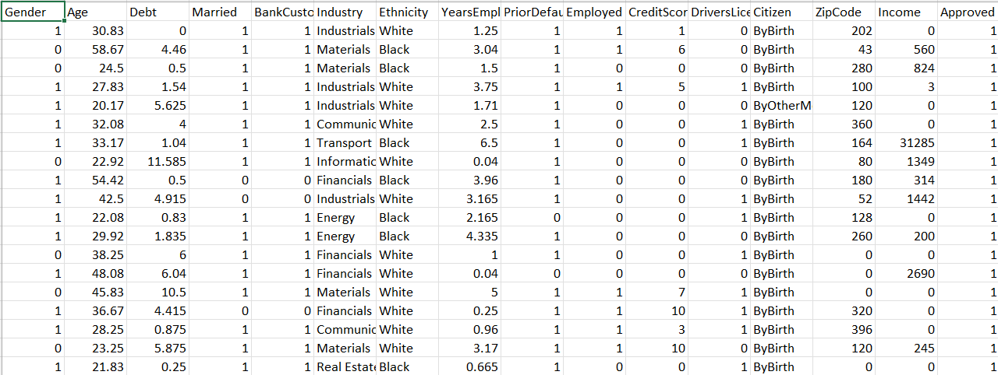
DATA
VARIABLE
The variables are of two types:
continuous and categorical data, where the continuous variables are in integer and float format and categorical variables are in object format
Data Set : There are 16 variables and 691 records
SOURCE:https://drive.google.com/drive/folders/1vGSRCnhqSxEH53BgLqhh32F1qNKqfOim?usp=drive_link
CATEGORICAL | CONTINUOUS
Gender | Age
Married | Debt
Bankcustomer | Yearsemployed
Industry | CreditScore
Ethinicity | Income
Priordefault
Emplyed
Driverlicense
Citizen

Slide 11
We have checked for NULL VALUES but there are no null values present in our data.
Then we proceeded to perform dummy variable encoding for which we divided the data into two parts, which are independent variables and dependent variables.
The categorical variables are encoded into continuous variables using the dummy variables.
The renamed columns after dummy variables encoding are shown below,
ORGINAL VARIABLES | RENAMED VARIABLES
Gender | Gender_b
Married | Married_y
Bankcustomer | Bankcustomer_p
Industry | Industry_c, Industry_cc,……
Ethinicity | Ethinicity_h, Ethinicity_j,…..
Priordefault | Priordefault_t
Employed | Employed_t
Driverlicense | Driverlicense_t
Citizen | Citizen_s

Slide 12
EXPLORATORY DATA
ANALYSIS

Slide 13
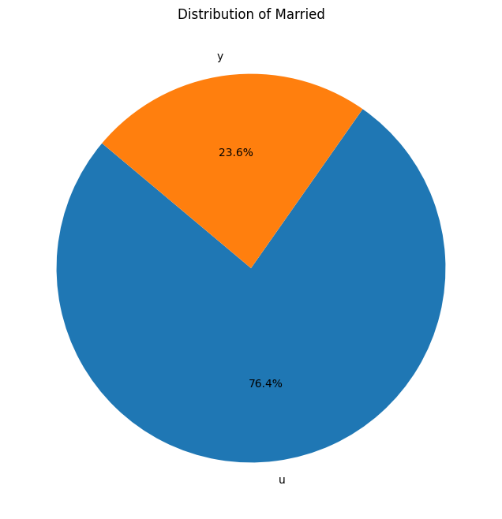
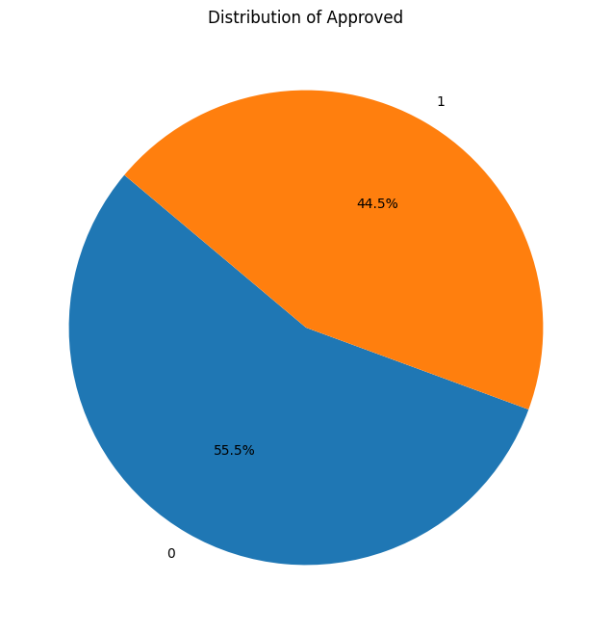
PIECHART
The first pie chart shows number of married people and the second pie chart shows the number of approvals

Slide 14
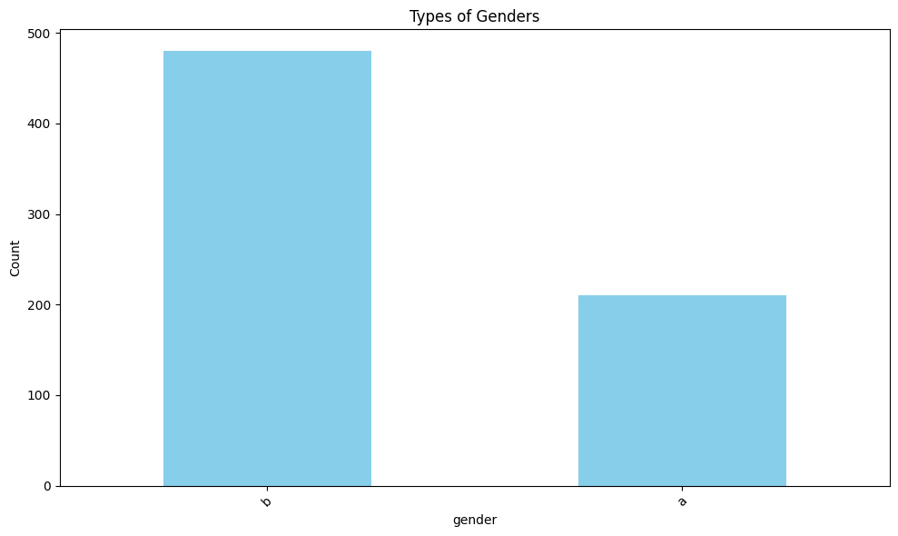
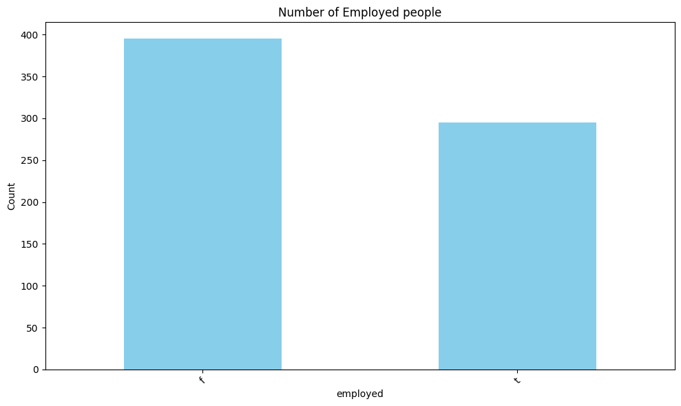
BARCHART
The first bar chart shows the distribution of Gender and the second one shows the distribution of employees

Slide 15
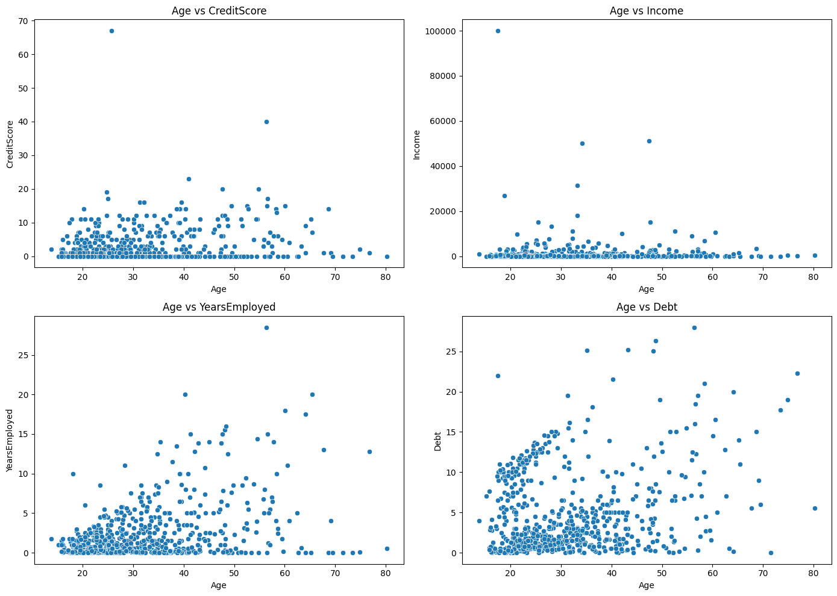
Scatterplot
The target variable “age” is plotted against the independent variables in the scatterplots as shown below

Slide 16
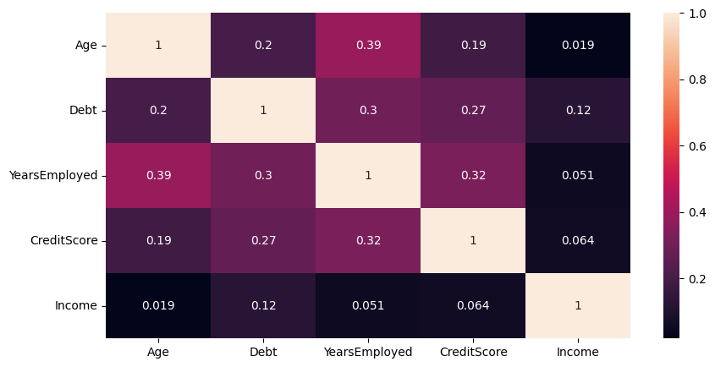
CORRELATION MATRIX
Here we can observe that Age and Years Employed have high positive correlation.
The next most positively correlated are Years Employed and Credit Score

Slide 17
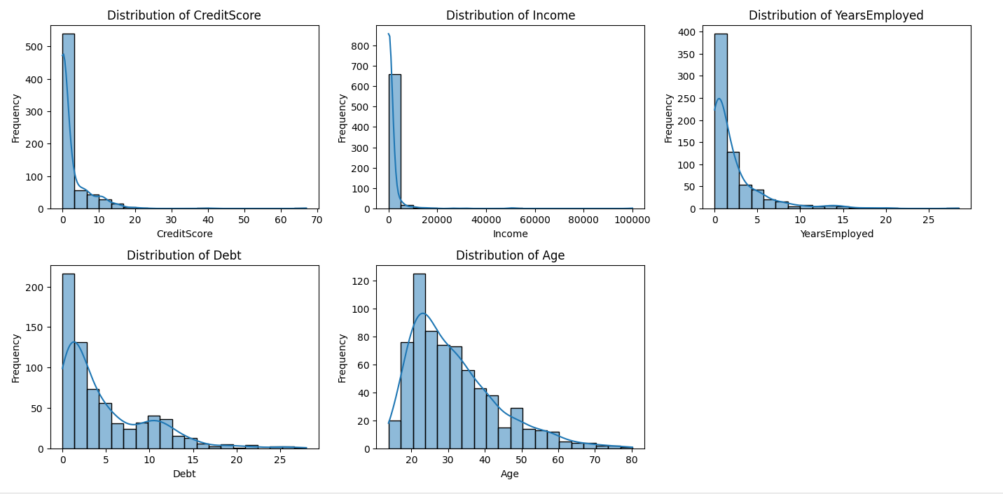
HISTOGRAM
The histograms display the distributions of various financial and demographic features. Here’s a summary interpretation for each plot

Slide 18
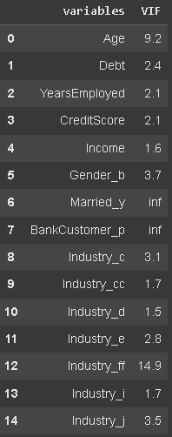
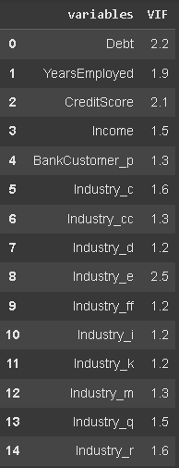
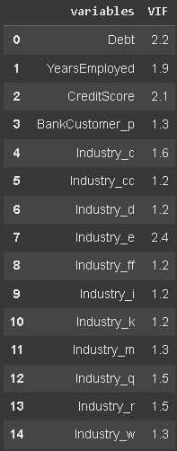
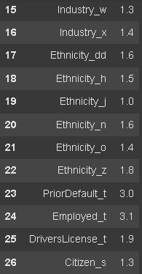
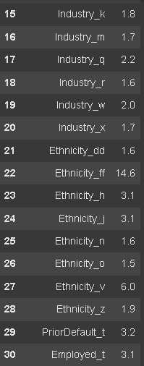
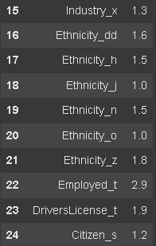
MULTICOLLINEARITY CHECK
We have removed the variables which are highly correlated to each other, the variables are 'Married_y','Ethnicity_ff','Age','Industry_j','Ethnicity_v','Gender_b','Income','PriorDefault_t'

Slide 19

MACHINE LEARNING ALGORITHM

Slide 20
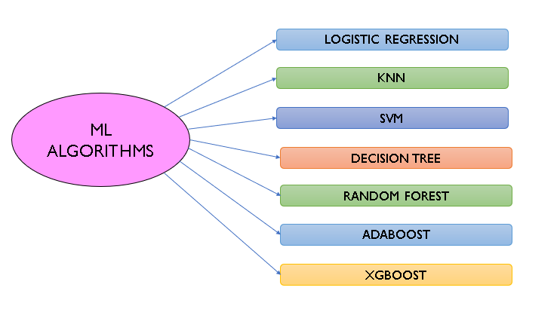

Slide 21
60-40 Train-Test-Split
Algorithms | MODEL-1(Before VIF) Accuracy | MODEL-2(After VIF) Accuracy
Logistic Regression | 0.822 | 0.775
KNN | 0.706 | 0.760
SVM | 0.836 | 0.753
Decision Tree | 0.847 | 0.750
Random Forest | 0.865 | 0.721
AdaBoost | 0.815 | 0.713
XGBoost | 0.862 | 0.779

Slide 22
70-30 Train-Test-Split
Algorithm | MODEL-1(Before VIF) Accuracy | MODEL-2(After VIF) Accuracy
Logistic Regression | 0.826 | 0.743
KNN | 0.681 | 0.743
SVM | 0.830 | 0.768
Decision Tree | 0.840 | 0.748
Random Forest | 0.864 | 0.700
AdaBoost | 0.821 | 0.758
XGBoost | 0.850 | 0.748

Slide 23
75-25 Train-Test-Split
Algorithm | MODEL-1(Before VIF) Accuracy | MODEL-2(After VIF) Accuracy
Logistic Regression | 0.826 | 0.757
KNN | 0.664 | 0.745
SVM | 0.820 | 0.774
Decision Tree | 0.843 | 0.745
Random Forest | 0.849 | 0.716
AdaBoost | 0.803 | 0.734
XGBoost | 0.855 | 0.774

Slide 24
80-20 Train-Test-Split
Algorithm | MODEL-1(Before VIF) Accuracy | MODEL-2(After VIF) Accuracy
Logistic Regression | 0.811 | 0.768
KNN | 0.644 | 0.717
SVM | 0.804 | 0.782
Decision Tree | 0.826 | 0.724
Random Forest | 0.840 | 0.673
AdaBoost | 0.782 | 0.746
XGBoost | 0.833 | 0.775

Slide 25
Algorithms Comparison
1. 60-40 Split Before Applying VIF
2. 80-20 Split After Applying VIF
Algorithm | Accuracy
Logistic Regression | 0.822
KNN | 0.706
SVM | 0.836
Decision Tree | 0.847
Random Forest | 0.865
AdaBoost | 0.815
XGBoost | 0.862
Algorithm | Accuracy
Logistic Regression | 0.768
KNN | 0.717
SVM | 0.782
Decision Tree | 0.724
Random Forest | 0.673
AdaBoost | 0.746
XGBoost | 0.775

Slide 26
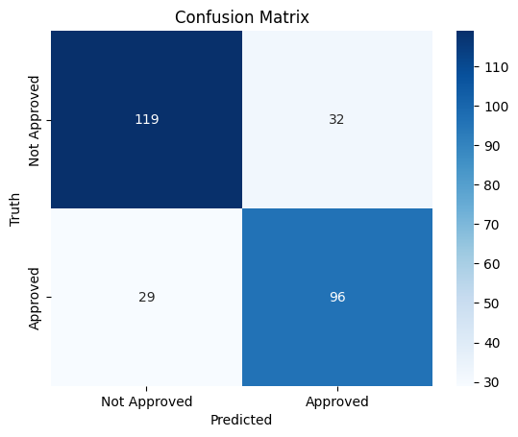
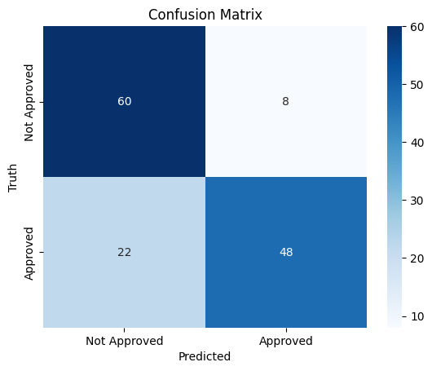
CONFUSION MATRIX
1. RANDOM FOREST before VIF for 60:40 split
2. SVM after VIF for 80:20 spit

Slide 27
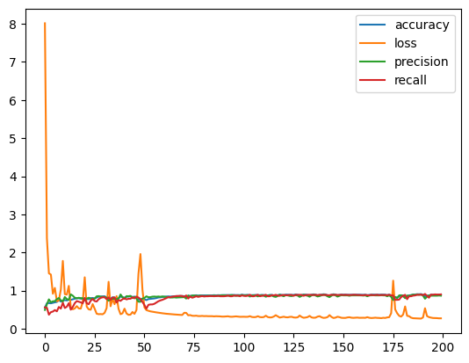
ANN Before VIF
Training Progress: Accuracy, Loss, Precision, and Recall for best split 60-40
SLPIT | ARCHITECTURE | OPTIMIZER | EPOCHS | ACCURACY
60-40 | 10-7-5-1 | Adam | 200 | 81.58
70-30 | 10-7-5-1 | Adam | 150 | 80.76
75-25 | 10-7-5-1 | Adam | 250 | 77.26
80-20 | 10-7-5-1 | Adam | 250 | 77.58

Slide 28
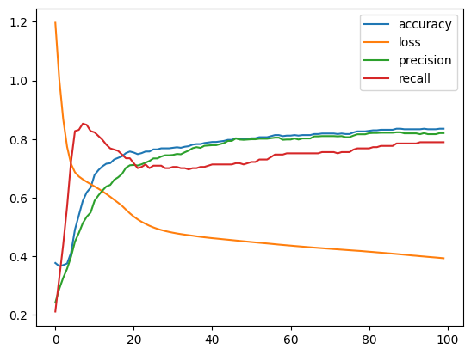
ANN After VIF
Training Progress: Accuracy, Loss, Precision, and Recall for best split 80-20
SLPIT | ARCHITECTURE | OPTIMIZER | EPOCHS | ACCURACY
60-40 | 10-7-5-1 | Adam | 250 | 73.91
70-30 | 10-7-5-1 | Adam | 150 | 76.39
75-25 | 10-7-5-1 | Adam | 100 | 73.77
80-20 | 10-7-5-1 | Adam | 250 | 77.49

Slide 29
SUMMARY:
The purpose of this research is to determine the best-performing machine learning techniques to predict Credit Card Approval.
So for the actual data we have Random Forest showing the best results with an Accuracy of 86.5% and XGBoost Algorithm showing next best Accuracy of 85.5%
And after removing the High Multicollinearity variables, the SVM Algorithm is showing the Best results with an Accuracy of 78.2%
From our study we conclude that random forest (Model-1) is to be considered for this analysis since it has better accuracy score when compared to SVM(Model-2)
The Artificial Neural Network (ANN) model has demonstrated reliable results (i.e. 81.58 accuracy); however, its accuracy is lower compared to the Machine Learning (ML) models. Therefore, for our dataset and study, the best-performing model is the ML model (Random Forest)

Slide 30
INSIGHTS:
Correlation Observations:Variables like age and income revealed interesting non-linear relationships, hinting that credit risk doesn’t increase linearly with age but stabilizes after a certain point.
Demographic Trends:Distribution patterns (e.g., marital status, employment sectors) provide deeper context about the applicant pool, allowing segmentation strategies for lenders.
Transparent and Equitable Approval Process: The analysis supports transparency by revealing decision patterns, fostering trust, and promoting fair access to credit, reducing biases in approvals which helps financial organizations to avoid credit risk and help practice fair lending to the eligible applicable

Slide 31
FUTURE SCOPE:
Integration of Advanced Machine Learning Model
Future work can explore more complex algorithms, such as ADVANCED DEEP LEARNING TECHNIQUES other than ANN to further improve the Accuracy of the model especially for challenging cases
Real Time Credit Scoring
Implementing models that can process and assess application in real-time, integrating up to date financial data which could lead to faster and more responsive credit card approval systems

Slide 32

Work Distribution
Team Member 1 (Chaitanya) | Collecting Information about credit card approvals and Literature Review
Team Member 2 (Srikanth) | Data Pre-processing and EDA
Team Member 3 (Harshit) | Implementing ML Algorithms

Slide 33

COLAB NOTEBOOK
THANK YOU
B.HARSHIT KUMAR
SRIKANTH YADAV
CHAITANYA JADAV

Slide 34

APPENDIX

Slide 35
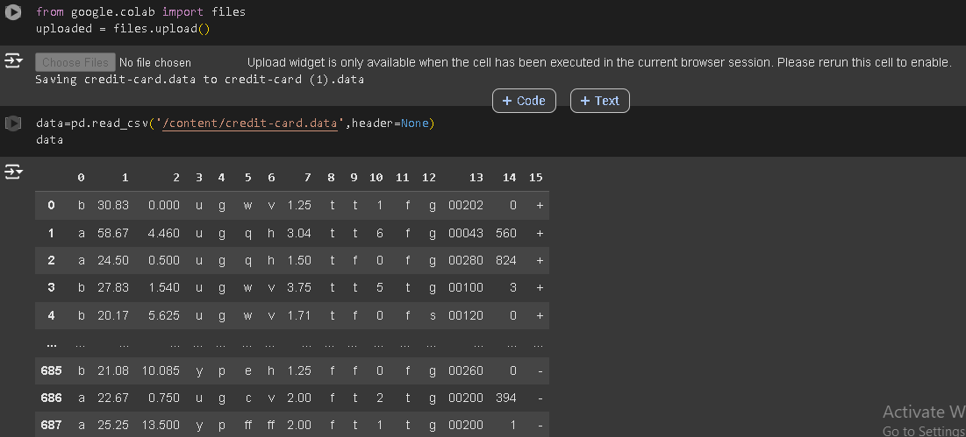
LOADING THE DATASET

Slide 36
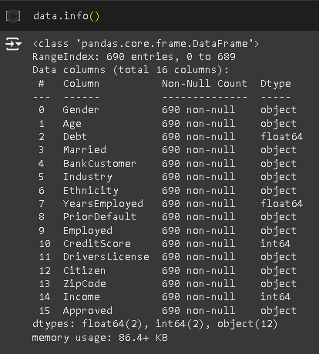
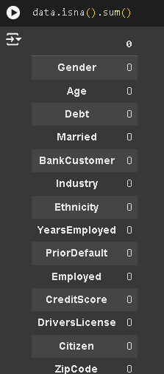
CHECKING DATA TYPES
CHECKING FOR NULL VALUES

Slide 37
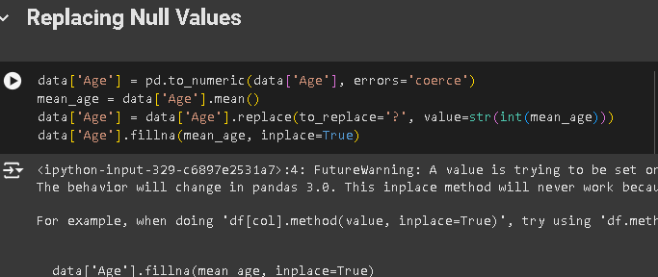
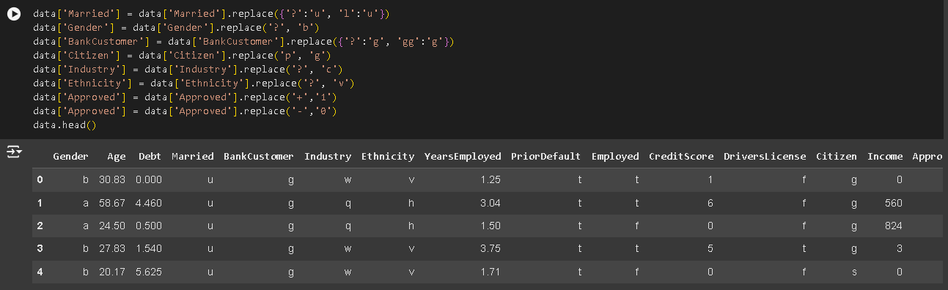
REPLACING THE “?” VALUES IN THE DATA

Slide 38
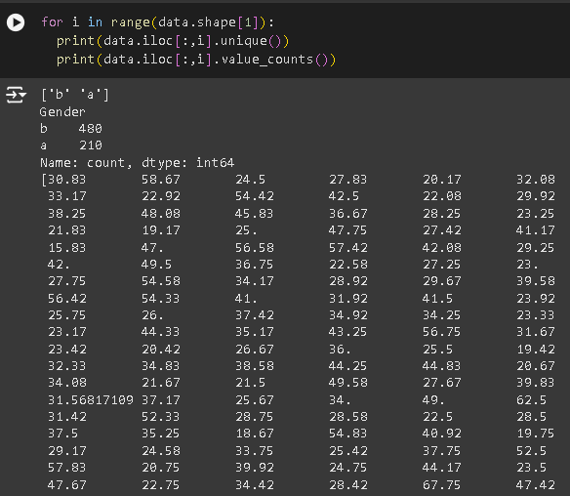
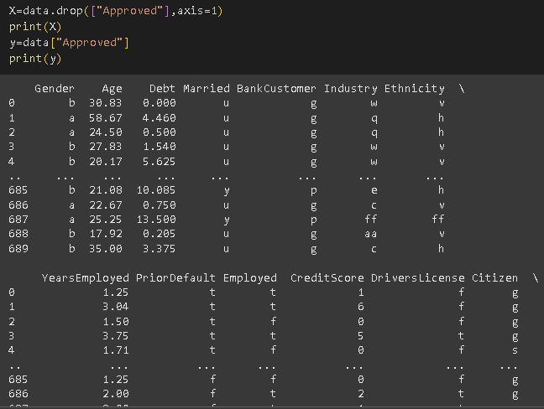
CHECKING THE UNIQUE VALUES AND ITS COUNT
DIVIDING THE DATA

Slide 39
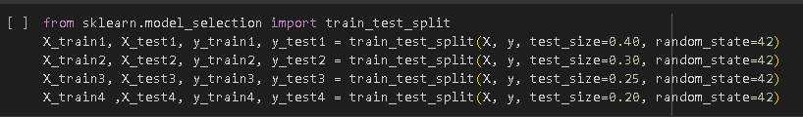
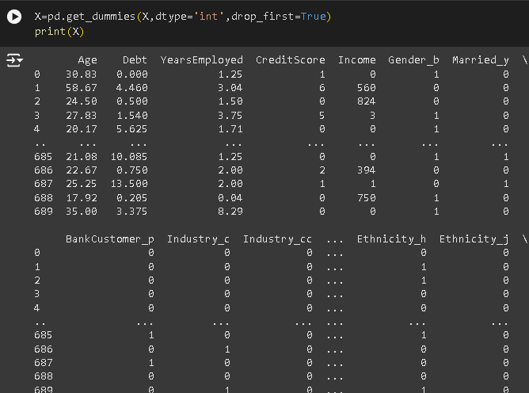
TRAIN –TEST-SPLIT
CREATING THE DUMMY VARAIBLES

Slide 40
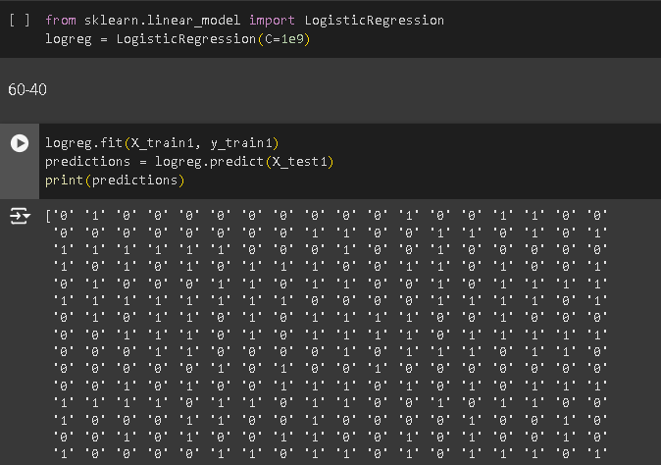
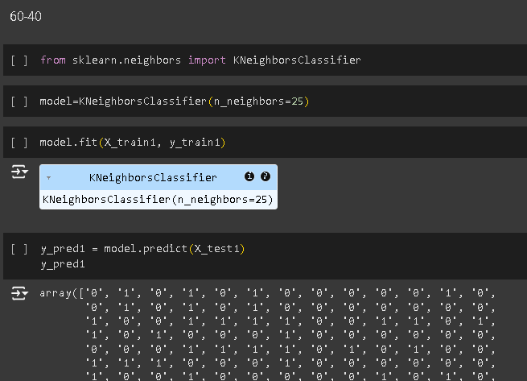
LOGISTIC REGRESSION BEFORE VIF
KNN BEFORE VIF

Slide 41
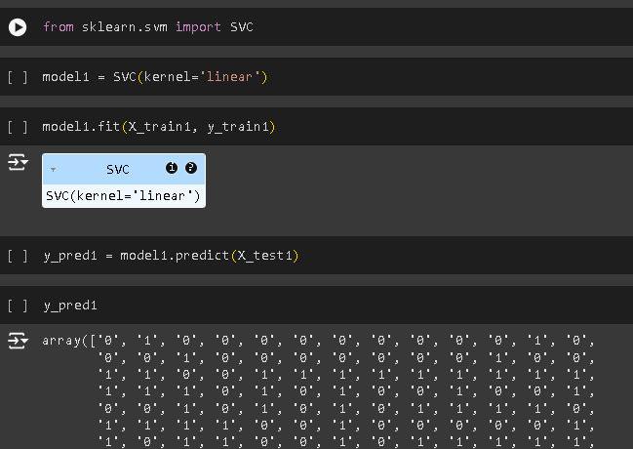
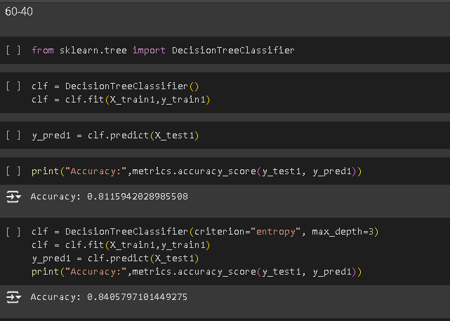
SVM BEFORE VIF
DECISION TREE BEFORE VIF

Slide 42
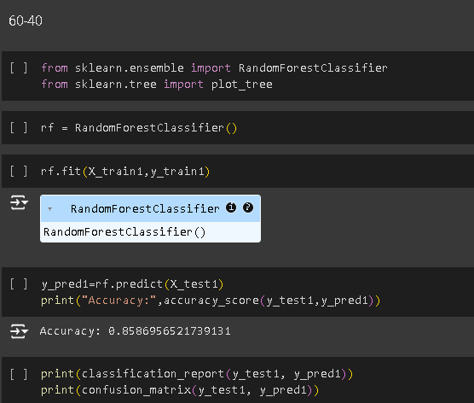
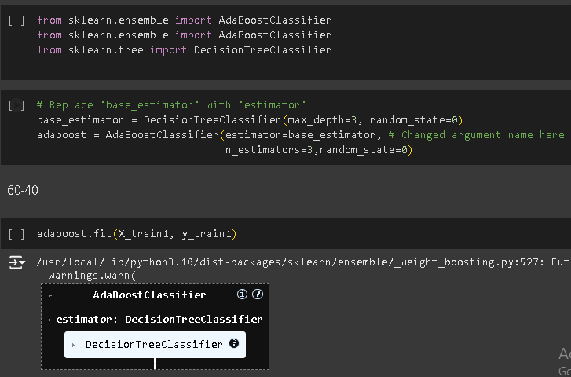
RANDOM FOREST BEFORE VIF
ADABOOST BEFORE VIF

Slide 43
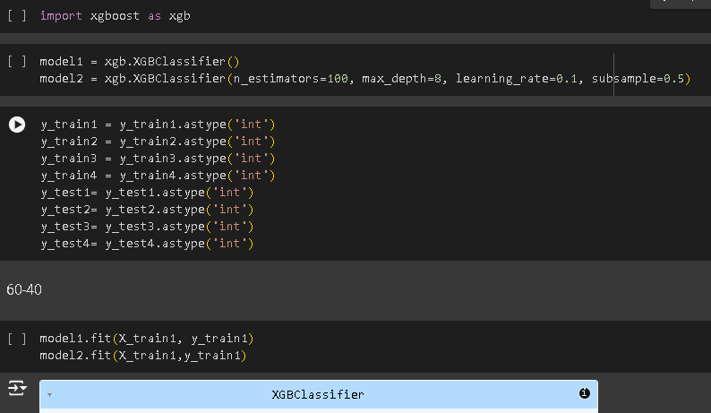
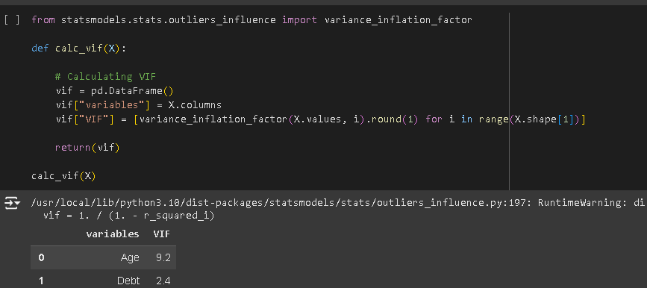
CHECKING FOR MULTI COLLINEARITY (VIF)
XGBOOST BEFORE VIF

Slide 44
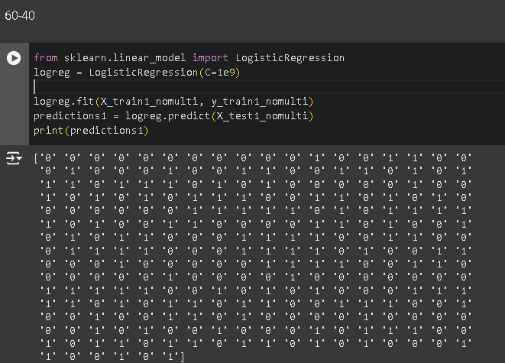
TRAIN-TEST-SPLIT AFTER REMOVING HIGH MULTICOLLINEARITY VARIABLS
LOGISTIC REGRESSION AFTER VIF

Slide 45
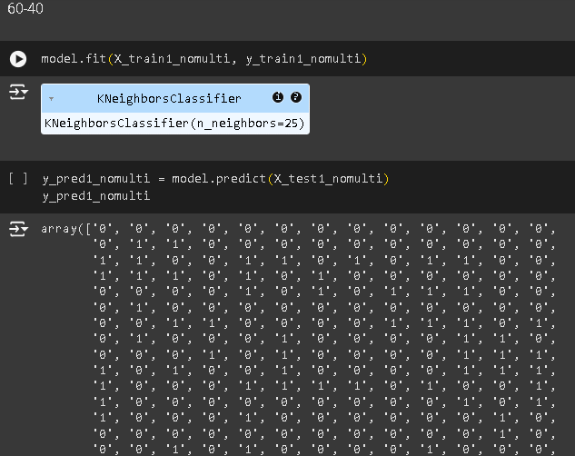
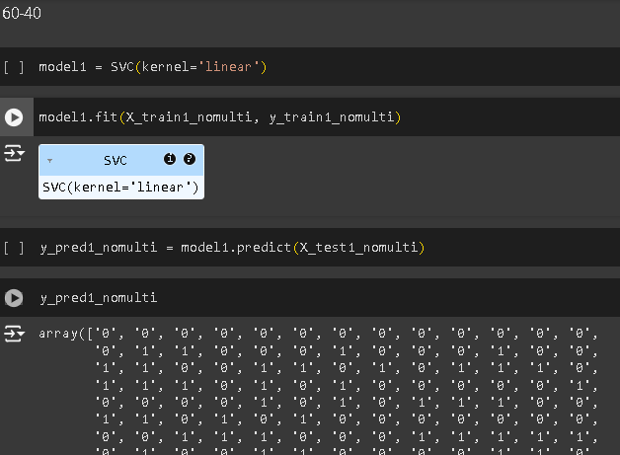
KNN AFTER VIF
SVM AFTER VIF

Slide 46
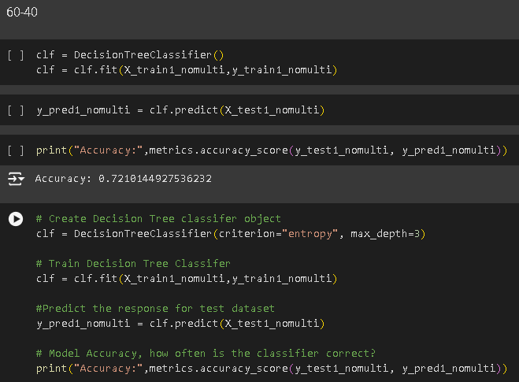
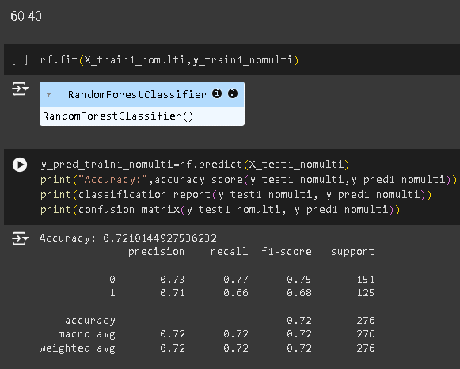
DECISION TREE AFTER VIF
RANDOM FOREST AFTER VIF

Slide 47
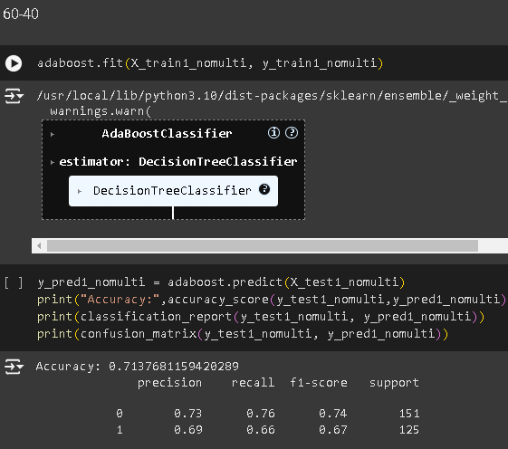
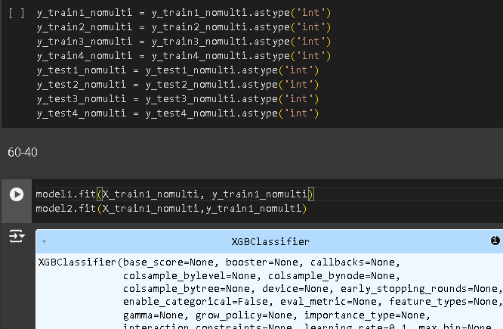
ADABOOST AFTER VIF
XGBOOST AFTER VIF

Slide 48
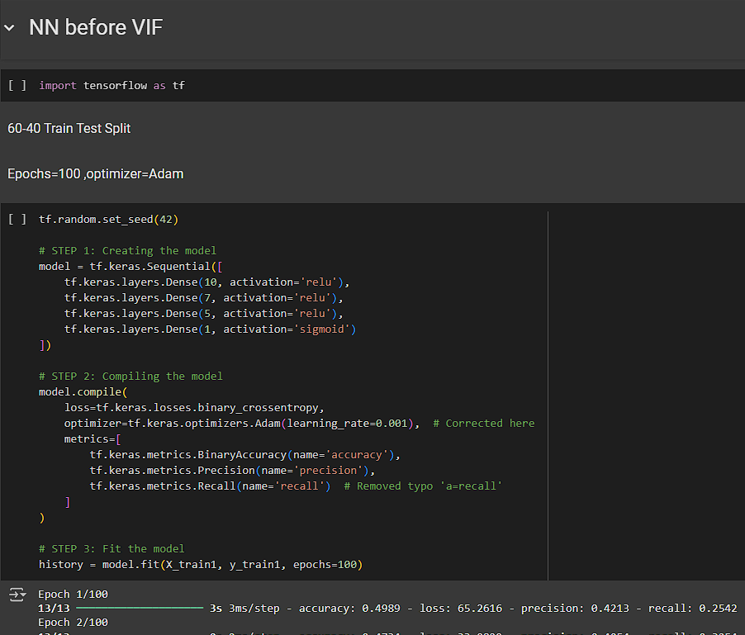
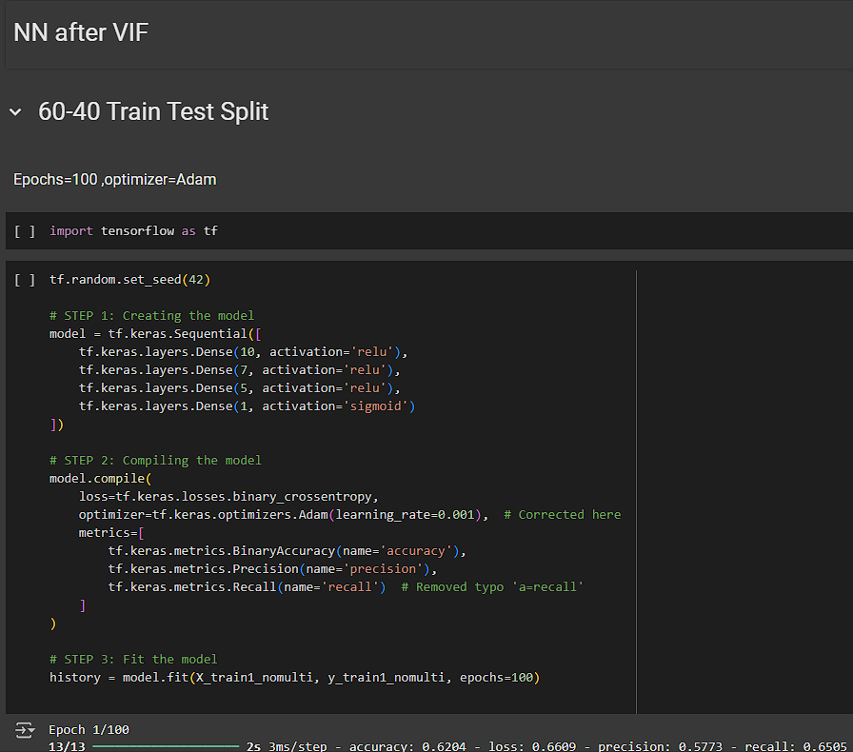
DEEP LEARNING MODEL(ANN)

